Slide 1
Module 2: Mathematical Physics I

Slide 2
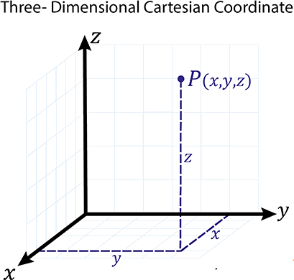
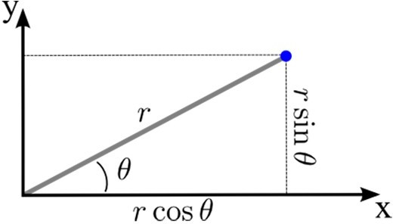
Frame of refrence

Slide 3
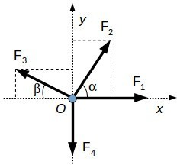
Scalar and vector
Scalar | Vector
Scalar quantity has only magnitude, but no direction | Vector quantity has both magnitude and direction.
Scalar quantities follow the rules of ordinary algebra. | Vector quantity follows the rules of vector algebra.
Divison of scalar with scalar is permitted. | Division between the vectors is not permitted.
Example: Mass, length, and energy etc. | Example: Force, displacement, and weight etc.

Slide 4
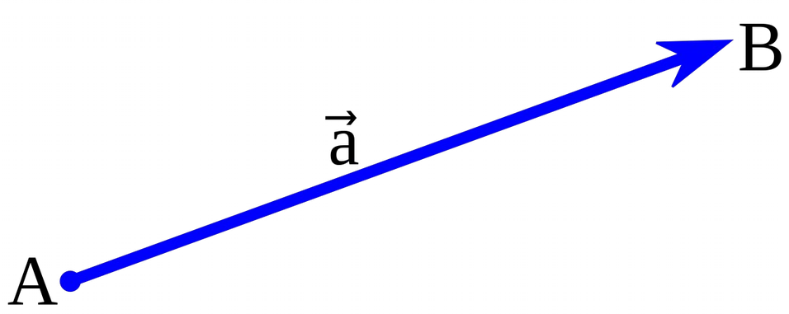
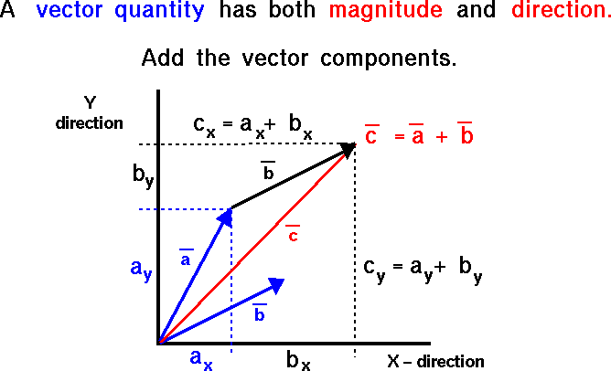
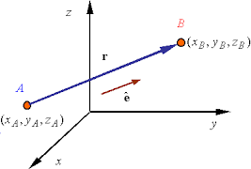
Vectors opreations

Slide 5

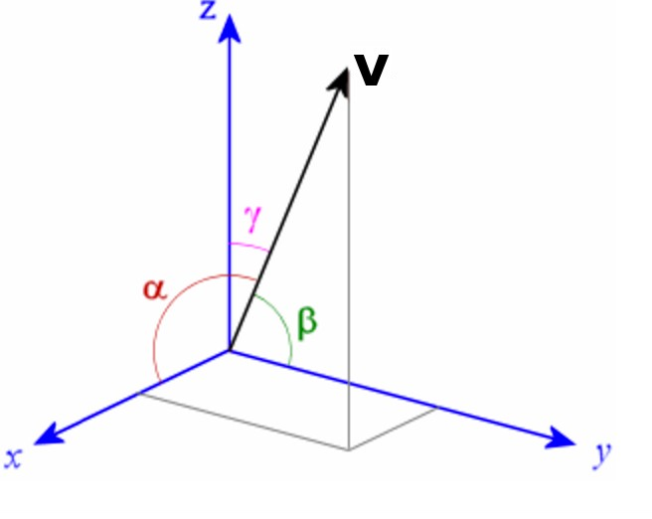
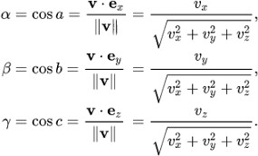
Vectors opreations
Unit vector

Slide 6
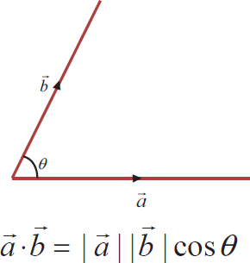

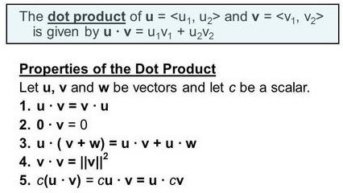
Vectors operations

Slide 7
Vectors operations
Find the angle between side AC and side AB of a triangle ABC. Coordinates of the vertices A,B,C are (1+2√3, 1, 2), (1, 1, 2), and
(1,3,2) respectively.
B (1, 1, 2)
A
(1+2√3, 1, 2)
C (1,3,2)

Slide 8
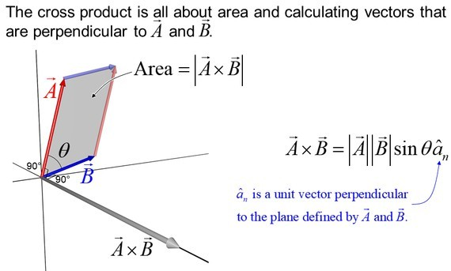
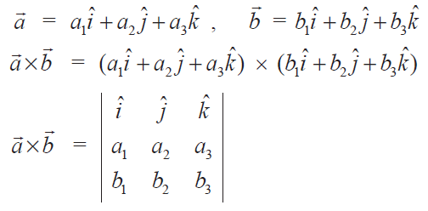
Vectors operations

Slide 9
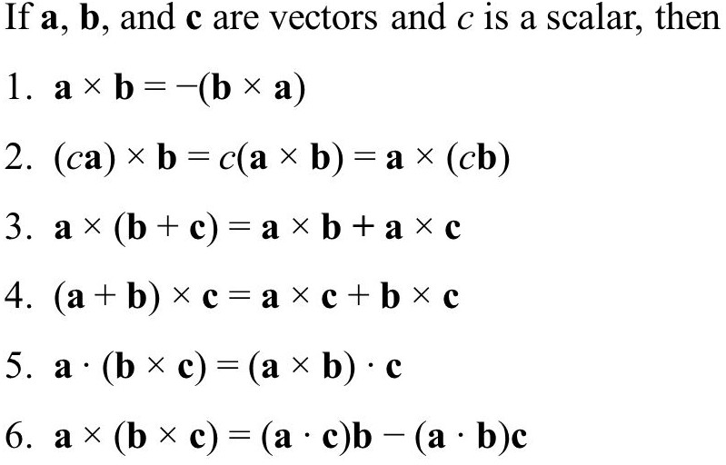
Vectors operations

Slide 10
Vectors operations
Find area vector and area that is orthogonal to the plane containing the points P=(3,0,1), Q=(4,−2,1), and R=(5,3,−1).
Q (4,−2,1)
P (3,0,1)
R (5,3,−1)

Slide 11

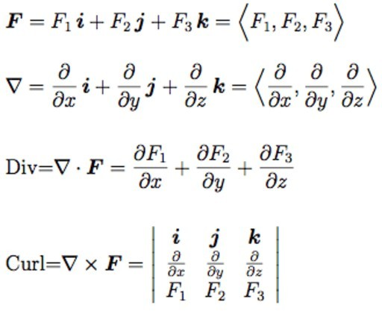

Gradient, divergence and curl
f is scalar

Slide 12
Gradient, divergence and curl
φ = x³yz³ and A = xz i – y² j + 2x²y k
Evaluate
❑φ
❑. A
❑x A

Slide 13
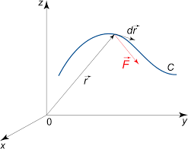
Integral
F=F_{x} i + F _{y} j + F_{z} k
d r=dx i +dy j +dz k
∫ F . d r=∫ F_{x} dx + F _{y} dy + F_{z} dz
c c
For F = (2xy+z³)i + (x²+2y)j + (3xz²-2)k,
∫ F . d r
Calculate
c
C is the path joining (1,-1,1), and (2,1,2)

Slide 14
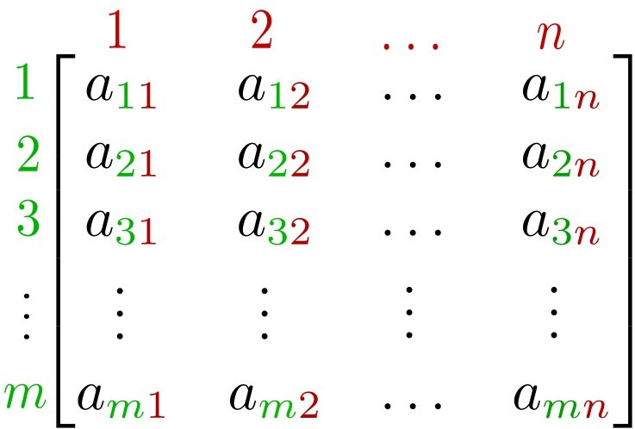
Matrix
3a - b = 7
-a + 7b - 6c = 2
-3b + 4c = 0
3 -1 0 a 7
-1 7 - 6 b = 2
0 -3 4 c 0
Rectangular list of numbers (or functions).

Slide 15
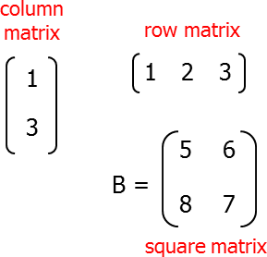
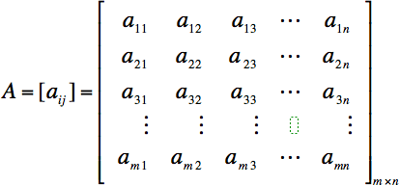
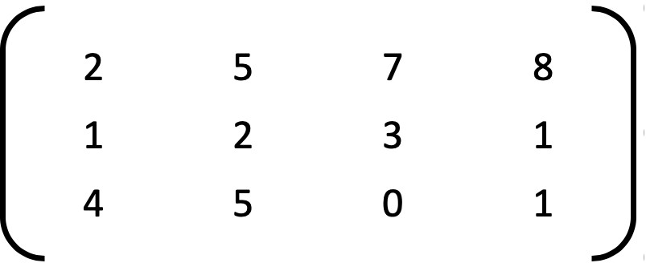
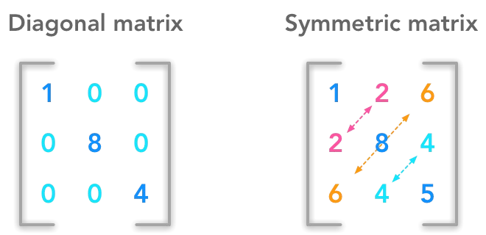
Matrix
rectangular matrix

Slide 16
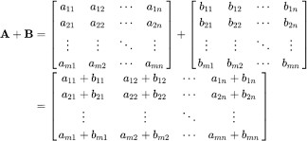
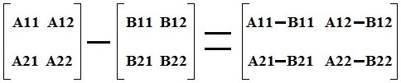




Matrix operations
Subtraction

Slide 17
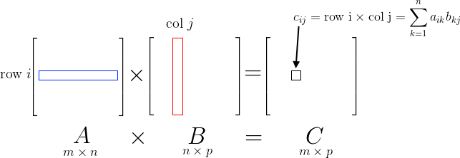
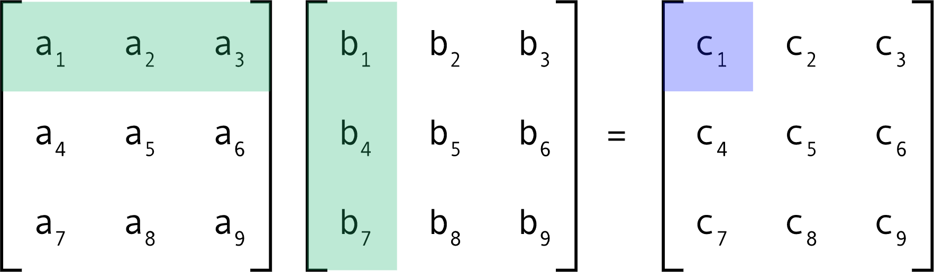
Matrix operations

Slide 18
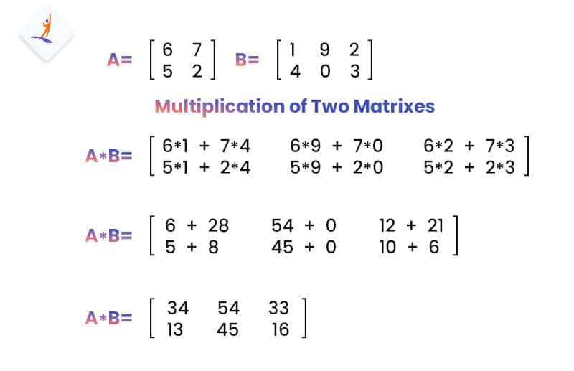

Slide 19
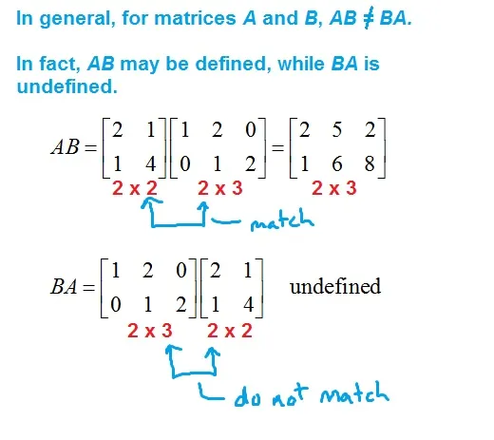

Slide 20

Matrix operations
Multiply the two matrices?

Slide 21
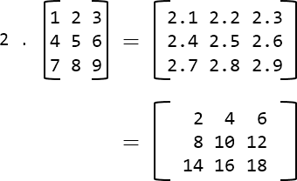
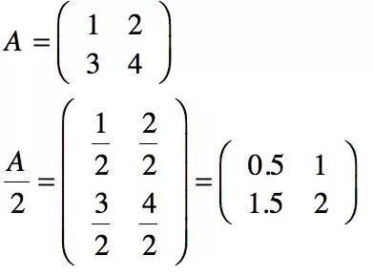
Matrix operations
Multiplication by a scalar
Division by a scalar

Slide 22
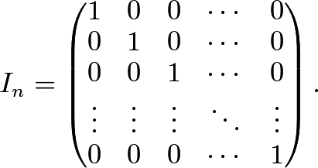
Matrix operations
Identity Matrix
For any given matrices A, B and C of the order m x n
A + B = B + A
A + (B + C) = (A + B) + C
k (A + B) = kA + kB, here k is a scalar

Slide 23
Matrix operations
A = {a_{ij}}_{mxn}, B = {b_{ij}}_{nxp}, and C = {c_{ij}}_{pxk}
(A B ) C = A (B C)
A (B + C) = A B + A C or (A + B) C = A C + BC I A = A I = A
 | 1 | 1 | -1
A = | 2 | 0 | 3
 | 3 | -1 | 2
 | 1 | 3 | 1 |  | 1 | 2 | 3
B = | 0 | 2 | -1 | C = | 2 | 0 | -2
 | -1 | 4 | 2 |  | -4 | 1 | 2
1 3 2
2 0 -1
1 2 3
Evaluate A³ - 4A² - 3A
A =

Slide 24
Matrix operations
A = {a_{ij}}_{mxn} then
A’ or A^{T} = {a } is called the transpose of A
ji nxm
For any sutable matrices A and B
3 | 4 | 4
3 | 2 | 1
2 | 0 | 2
A’ =
(A’)’ = A
k (A)’ = (k A)’ where k is a scalar
3 3 2
2 -1 2
A = 4 2 | 0 | B = | 1 | 2 | 4
4 1 | 2 |  | 3 | 6 | 1
(A + B)’ = A’ + B’
Prove the above identities
(AB)’ = B’ A’
Also calculate (A + B) (A – B)

Slide 25
Matrix operations
Any matrix A = {a_{ij}}_{mxm} is said to symmetric if A = A’. If A = -A’, then matrix is said to be skew, symmetric.
If a matrix is skew symmetric, then a_{ii} = -a_{ii} = 0, i.e., all the diagonal elements of a skew symmetric matrix are 0.
For any square matrix A, (A + A’) is symmetric and (A – A’) is skew symmetic.
Let B = (A + A’), then B’ = (A + A’)’
B’ = A’ + (A’)’ = (A’ + A) = (A + A’) = B

Slide 26
Matrix operations
C = (A – A’) then C’ = (A – A’)’
C’ = A’ - (A’)’ = (A’ - A) = - (A - A’) = -C
Thus, any symmetric matrix can be expressed as sum of a symmetric and a skew symmetric matrix.
A = 1/2(B + C) = 1/2 (A + A’) + 1/2 (A - A’)
Prove the previous identites for
 | 2 | -2 | -4
A = | -1 | 3 | 4
 | 1 | -2 | -3

Slide 27
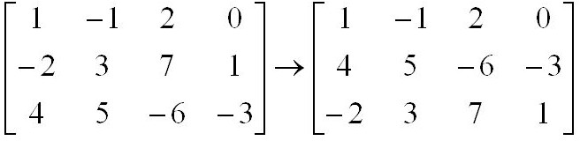

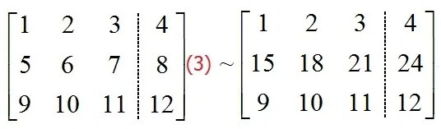
Matrix operations
Matrix transformation
(1) The interchange of any two rows or two columns.
(2) The multiplication of the elements of any row or column by a non zero number.

Slide 28
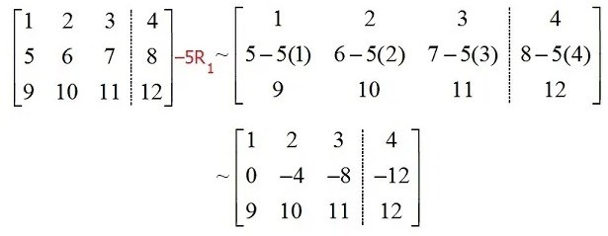
Matrix operations
(3) The addition to the elements of any row or column, the corresponding elements of any other row or column multiplied by any non zero number.

Slide 29
Matrix operations
If A is a square matrix of order m × m, and if there exists another square matrix B of the same order m × m, such that AB = BA = I, then, A is said to be invertible matrix and B is called the inverse matrix of A and it is denoted by A^{–1}.
A rectangular matrix does not possess its inverse, since for the products BA and AB to be defined and to be equal, it is necessary that matrices A and B should be square matrices of the same order.
If A and B are invertible matrices of same order, then (AB)^{–1} = B^{–1} A^{–1} .
Inverse martix can be calculated by the matrix transformations (row and column transformations).
A = AI I = AB
via elementary row and column operations

Slide 30
Matrix operations
R₁ = R₁+ R₂
3 | 0 | 2
2 | 0 | -2
0 | 1 | 1
1 | 0 | 0
0 | 1 | 0
0 | 0 | 1
5 | 0 | 0
2 | 0 | -2
0 | 1 | 1
1 | 1 | 0
0 | 1 | 0
0 | 0 | 1
A
I
1 | 0 | 0
1 | 0 | -1
0 | 1 | 1
0.2 | 0.2 | 0
0 | 0.5 | 0
0 | 0 | 1
1 | 0 | 0
2 | 0 | -2
0 | 1 | 1
0.2 | 0.2 | 0
0 | 1 | 0
0 | 0 | 1
R₂ = R₂/2
R₁ = R₁/5

Slide 31
Matrix operations
1 | 0 | 0
0 | 0 | -1
0 | 1 | 1
0.2 | 0.2 | 0
-0.2 | 0.3 | 0
0 | 0 | 1
1 | 0 | 0
0 | 1 | 0
0 | 1 | 1
0.2 | 0.2 | 0
-0.2 | 0.3 | 1
0 | 0 | 1
R₂ = R₂-R₁
R₂ = R₂+R₃
1 | 0 | 0
0 | 1 | 0
0 | 0 | 1
0.2 | 0.2 | 0
-0.2 | 0.3 | 1
0.2 | -0.3 | 0
R₃ = R₃-R₂

Slide 32
Matrix operations
Find the inverse of the given matrix
3 | 2 | 1
2 | 3 | 1
1 | 1 | 4

Slide 33
Matrix operations
A system of linear equations can be solved using the matrix inversion operation a₁₁x₁ + a₁₂x₂ + a₁₃x₃ + ..........+ a_{1n}x_{n} = h₁
A X = H
a x + a x + a x + ..........+ a x = h
21 1
22 2
23 3
2n n 2
A⁻¹AX = A⁻¹H
IX = A⁻¹H
X = A⁻¹H
.
.
.
.
a_{n1}x₁ + a_{n2}x₂ + a_{n3}x₃ + ..........+ a_{nn}x_{n} = h_{n}
ª11 | ª12 | ª13 | ...... | ª1n
ª21 | ª22 | ª23 | ...... | ª2n
.
.
ªn1 | ªn2 | ªn3 | ...... | ªnn
x₁
h₁
x₂
h₂
A =
X =
H =
.
.
.
.
x_{n}
h_{n}

Slide 34
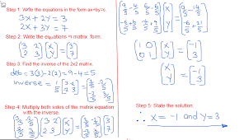

Slide 35
Matrix operations
Solve the following using matrix method 2x₁ + x₂ + 2x₃ + x₄ = 6
6x₁ - 6x₂ + 6x₃ + 12x₄ = 36
4x₁ + 3x₂ + 3x₃ - 3x₄ = – 1
2x₁ + 2x₂ - x₃ + x₄ = 10

Slide 36
Matrix operations
ª11 | ª12 | ª13 | ...... | ª1n
ª21 | ª22 | ª23 | ...... | ª2n
.
.
ªn1 | ªn2 | ªn3 | ...... | ªnn
x₁
h₁
x₂
h₂
A =
X =
H =
.
.
.
.
x_{n}
h_{n}
|A – λI| = 0, here λ is scalar λ is the eigen value of A

Slide 37
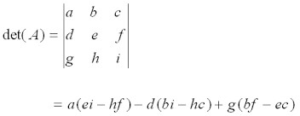
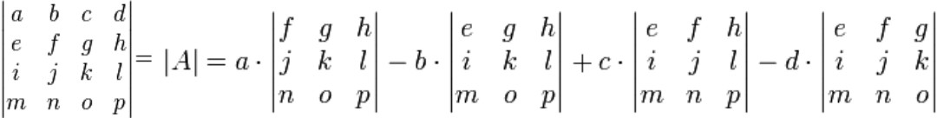
Matrix operations

Slide 38
Matrix operations
3 | -3 | 3
2 | 1 | 1
1 | 5 | 6
Find the eigen values of the given matrix
Eigen values also be determined by diagonilization of matrix.

Slide 39
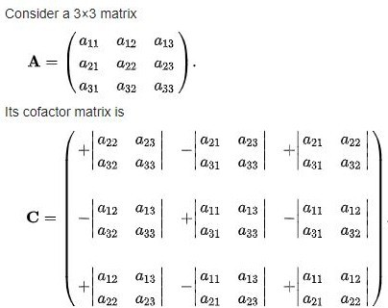
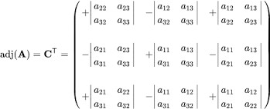
Matrix operations
Inverse of the matrix can also be calculated using
A⁻¹ = adj(A)
A

Slide 40
Matrix operations
3 | -3 | 4
2 | -3 | 4
0 | -1 | 1
Find the inverse of matrix

Slide 41
Vectors: computer
import numpy as np
list1 = [1, 2, 3]
list2 = [[10],
[20],
[30]]
vector1 = np.array(list1) vector2 = np.array(list2)
print("Horizontal Vector") print(vector1)
print("----------------")
print("Vertical Vector") print(vector2)

Slide 42
Vectors: computer
import numpy as np list1 = [5, 6, 9]
list2 = [1, 2, 3]
vector1 = np.array(list1)
print("First Vector : " + str(vector1)) vector2 = np.array(list2)
print("Second Vector : " + str(vector2)) addition = vector1 + vector2
print("Vector Addition : " + str(addition))

Slide 43
Vectors: computer
import numpy as np list1 = [5, 6, 9]
list2 = [1, 2, 3]
vector1 = np.array(list1)
print("First Vector : " + str(vector1)) vector2 = np.array(list2)
print("Second Vector : " + str(vector2)) addition = vector1 + vector2
print("Vector Addition : " + str(addition)) subtraction = vector1 - vector2
print("Vector Substraction : " + str(subtraction))

Slide 44
Vectors: computer
import numpy as np list1 = [5, 6, 9]
list2 = [1, 2, 3]
vector1 = np.array(list1)
print("First Vector : " + str(vector1)) vector2 = np.array(list2)
print("Second Vector : " + str(vector2)) addition = vector1 + vector2
print("Vector Addition : " + str(addition)) subtraction = vector1 - vector2
print("Vector Substraction : " + str(subtraction))
multiplication = vector1 * vector2
print("Vector Multiplication : " + str(multiplication)) division = vector1 / vector2
print("Vector Division : " + str(division))

Slide 45
Vectors: computer
import numpy as np list1 = [5, 6, 9]
list2 = [1, 2, 3]
vector1 = np.array(list1)
print("First Vector : " + str(vector1)) vector2 = np.array(list2)
print("Second Vector : " + str(vector2)) dot_product = vector1.dot(vector2)
print("Dot Product : " + str(dot_product))

Slide 46
Vectors: computer
import numpy import array
a=[5,6,9]
b=[1,3,4]
dot = 0.0;
for i in range(len(a)): dot += a[i] * b[i]
print("dot_product = "+ str(dot))

Slide 47
Vectors: computer
Import numpy as np
A =[2, 7, 4]
B =[3, 9, 8]
vector1=np.array(A) vector2=np.array(B)
cross_product=np.cross(vector1, vector2) print("Cross product :" +str(cross_product))

Slide 48
Vectors: computer
vect_A = [3, -5, 4]
vect_B = [2, 6, 5] cross_P = [ ]
cross_P.append(vect_A[1] * vect_B[2] - vect_A[2] * vect_B[1]) cross_P.append(vect_A[2] * vect_B[0] - vect_A[0] * vect_B[2]) cross_P.append(vect_A[0] * vect_B[1] - vect_A[1] * vect_B[0])
print("Cross product:", end =" ") for i in range(0, 3):
print(cross_P[i], end =" ")

Slide 49
Matrices: computer
import numpy as np
M1 = np.array([[5, -10, 15],
[3, -6, 9], [-4, 8, 12]])
print(M1)

Slide 50
Matrices: computer
import numpy as np
M1 = np.array([[3, 6, 9], [5, -10, 15], [-7, 14, 21]])
M2 = np.array([[9, -18, 27], [11, 22, 33], [13, -26, 39]])
M3 = M1 + M2
print(M3)

Slide 51
Matrices: computer
import numpy as np
M1 = np.array([[3, 6, 9], [5, -10, 15], [-7, 14, 21]])
M2 = np.array([[9, -18, 27], [11, 22, 33], [13, -26, 39]])
M3 = M1 - M2
print(M3)

Slide 52
Matrices: computer
import numpy as np
M1 = np.array([[3,6,9],[5,-10,15],[-7,14,21]])
M2 = np.array([[9,-18,27],[11,22,33],[13,-26,39]]) M3 = M1.dot(M2)
print(M3)
import numpy as np
mat1 = ([1, 6, 5],[3 ,4, 8],[2, 12, 3])
Mat2 = ([3, 4, 6],[5, 6, 7],[6, 56, 7])
res = np.dot(mat1,mat2) print(res)

Slide 53
Matrices: computer
matrix1 = [[12,7,3],
[4 ,5,6],
[7 ,8,9]]
matrix2 = [[5,8,1],
[6,7,3],
[4,5,9]]
res = [[0 for x in range(3)] for y in range(3)]
for i in range(len(matrix1)):
for j in range(len(matrix2[0])): for k in range(len(matrix2)):
res[i][j] += matrix1[i][k] * matrix2[k][j] print (res)

Slide 54
Matrices: computer
M1 = np.array([[3, 6, 9], [5, -10, 15], [4,8,12]])
M2 = M1.transpose() print(M1)
print(M2)

Slide 55
Matrices: computer
X = [[12,7],
[4 ,5],
[3 ,8]]
result = [[0,0,0],
[0,0,0]]
for i in range(len(X)):
for j in range(len(X[0])):
result[j][i] = X[i][j]
for r in result: print(r)

Slide 56
Matrices: computer
import numpy as np
A = np.array([[6, 1, 1], [4, -2, 5], [2, 8, 7]])
B = np.linalg.inv(A) print (B)

Slide 57
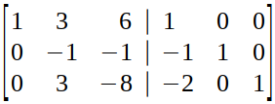

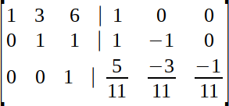
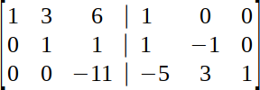
Matrices: computer
A
I

Slide 58
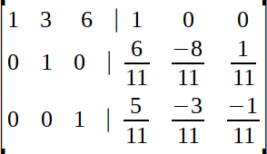
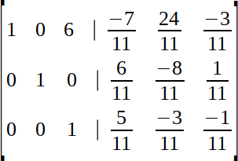
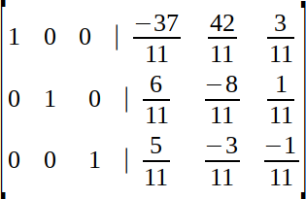
Matrices: computer

Slide 59
Matrices: computer
3 | 3 | 4
2 | -3 | 4
0 | -1 | 1

